Slide 1
Veterans Day: History and Background

Slide 2
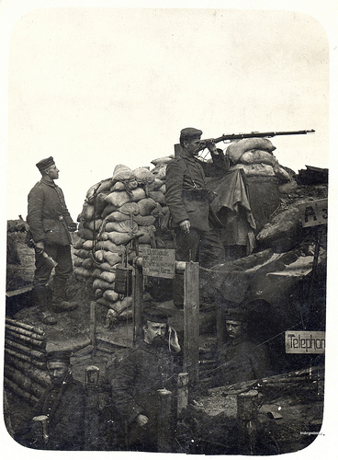
World War I
In 1918, World War I, “The Great War”, was being fought between the Allies and Germany
An armistice was implemented at the 11th hour of the 11th day of November, 1918
The war officially ended when the Treaty of Versailles was signed on June 28, 1919 in France
Photo courtesy of Drake Goodman
http://www.flickr.com/photos/29007475@N08/3550475347/
An armistice is a temporary cessation of fighting by mutual consent; a truce. TheFreeDictionary http://www.thefreedictionary.com/armistice

Slide 3
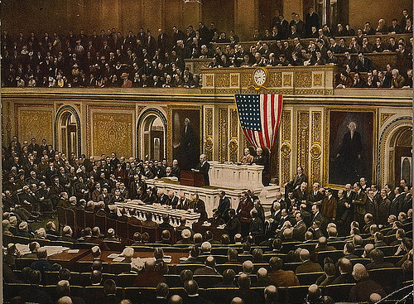
Armistice Day
In November 1919, President Woodrow Wilson proclaimed November 11th as the first commemoration of Armistice Day
Events such as parades, public meetings and a brief suspension of business were held beginning at 11 am
Photo courtesy of Bob Bobster
http://www.flickr.com/photos/32912172@N00/3372782033/

Slide 4
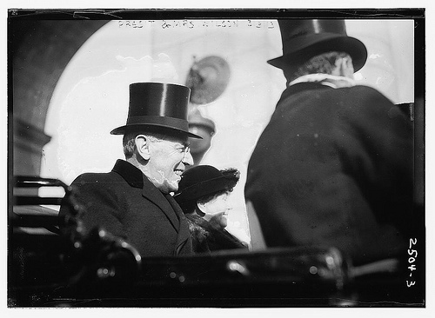
Presidential Quote
"To us in America, the reflections of Armistice Day will be filled with solemn pride in the heroism of those who died in the country’s service and with gratitude for the victory, both because of the thing from which it has freed us and because of the opportunity it has given America to show her sympathy with peace and justice in the councils of the nations…"
- President Woodrow Wilson, November 1919
Photo courtesy of The Library of Congress
http://www.flickr.com/photos/library_of_congress/2615541527/

Slide 5
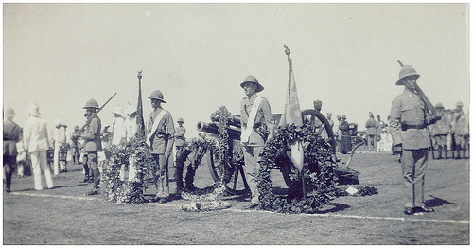
Recognized by Congress
An Act (52 Stat. 351; 5 U. S. Code, Sec. 87a) approved May 13, 1938, made the 11th of November in each year a legal holiday
A day dedicated to the cause of world peace and to be celebrated and known as "Armistice Day."
The day was established to honor World War I veterans
Photo courtesy of Lenton Sands
http://www.flickr.com/photos/lenton_sands/1592502449/

Slide 6
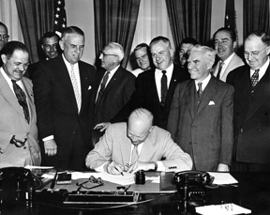
Veterans Day
On June 1, 1954, President Dwight Eisenhower signed legislation changing Armistice Day to Veterans Day
This day would now honor American veterans of all wars
On October 8, 1954, the President issued a proclamation for all organizations to work together “in order to insure proper and widespread observance of this anniversary”
Photo courtesy of the U.S. Department of Veterans Affairs
http://www1.va.gov/opa/vetsday/vetdayhistory.asp

Slide 7
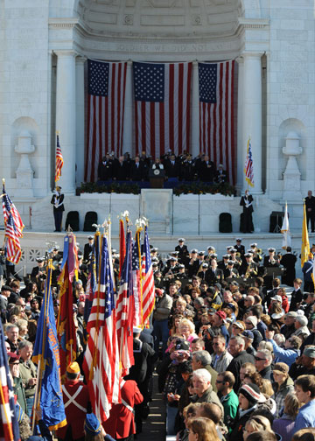
Observance Date Changes
On June 28, 1968 legislation was signed to have Veterans Day celebrated on the 4th Monday of October
Many states did not agree with this decision and continued to celebrate the holiday on November 11th
On September 20th, 1975, President Gerald Ford signed legislation to return Veterans Day to its original date of November 11th
Photo courtesy of the U.S. Department of Veterans Affairs
http://www1.va.gov/opa/vetsday/08images/9.jpg

Slide 8
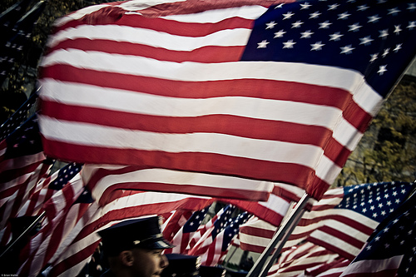
Veterans Day Presently
Veterans Day remains a celebration to honor America's veterans for their patriotism, love of country, and willingness to serve and sacrifice for the common good.
Photo courtesy of Brian Walter
http://www.flickr.com/photos/ptchfork/3023728732/

Slide 9
References
United States Department of Veterans Affairs
History of Veterans Day Webpage
http://www1.va.gov/opa/vetsday/vetdayhistory.asp
United States Army Center of Military History
The History of Veterans Day
http://www.history.army.mil/faq/vetsday/vetshist.htm

